Slide 1

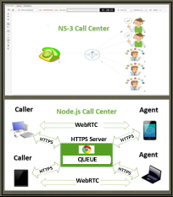
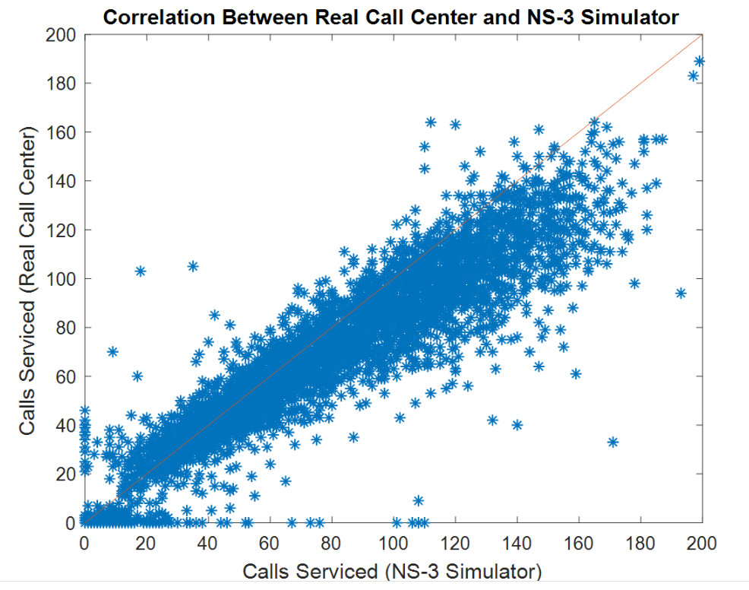
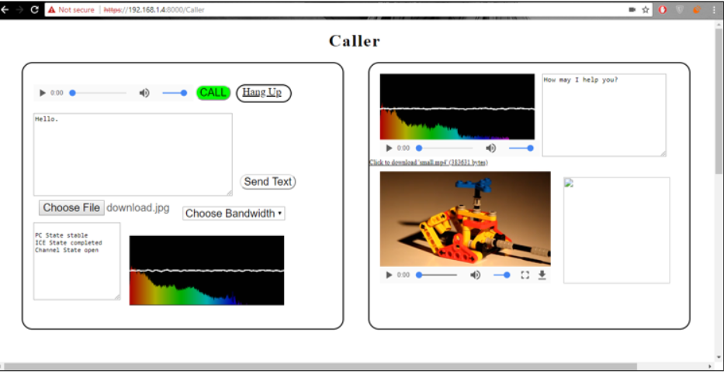
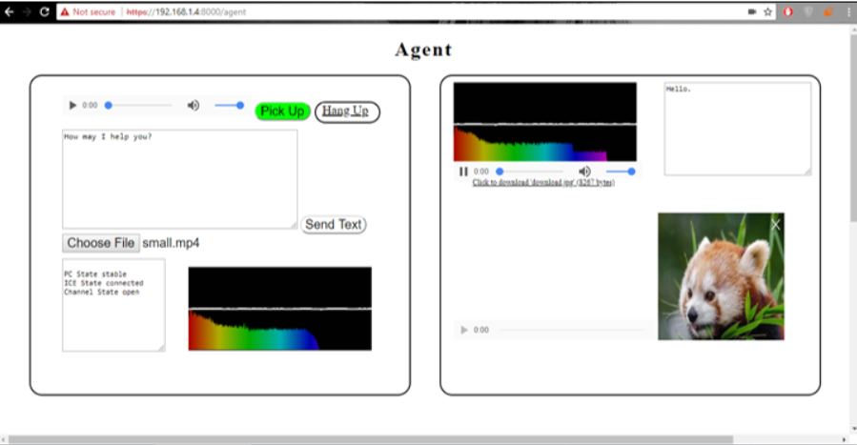
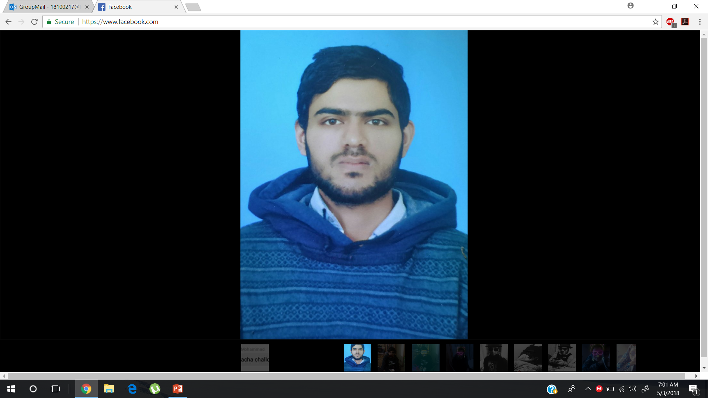



Advisor: Dr. Tariq Mahmood Jadoon
Call Center Simulation in NS-3 and Node.js​
SProj Overview
Call Center Simulation in NS-3 with calls denoted by IP Packets.
Web based Call Center made using HTTPS and WebRTC in Node.js
Proposed Approach
NS-3 Call Center
A caller generates IP Packets.
Packet Size determines Call Duration.
If all Agents are busy, calls are added to Linked List Queue.
Node.js Call Center
A local HTTPS Server listens for connection requests.
A user can choose to visit either Agent or Caller web page.
Agent- Caller Pair is connected by a bidirectional Audio and Data channel.
Design and Simulation Results
Related Work
1. NS-3 Call Center
Correlation
between NS-3
Simulator and
Real Call
Center
performance.
2. Node.js Call Center
Send Audio, Text and Files.
Multiple Audio Codecs and Bandwidths.
Various Routing Schemes.
Fourier Transform Visualizer.
Design Methodology
Caller Web Page
Agent Web Page
Future Work
Tweak NS-3 Simulation to enable accurate simulation of different Call Centers and Queuing Systems.
Obtain Certification to expand the reach of Web Server so that it can be deployed for education, businesses, marketing, hospitals etc.
Insert
photo here
Insert
photo here
Insert
photo here
Muhammad
Shamaas
Zarmeen Khan
Hira Tariq
Ammarah Azmat

